Slide 1
HL7/CMS Connectathon
PACIO Project
01/15/20

Slide 2
Objectives
What is a connectathon?
PACIO Project goals for the connectathon
CMS Data Element Library goals for the connectathon
Connectathon debrief
Next Steps

Slide 3

What is a Connectathon?
An opportunity for multiple vendors to test the client and/or server in a structured environment and provide constructive feedback
Most connectathon participants take the role of server or client depending on the organization they represent
A valuable way for members to obtain constructive feedback on their Implementation Guide (IG)
A connectathon can be described as a “test kitchen” and the Implementation Guide as a “recipe” that can be tested and refined by participants
Image by congerdesign from Pixabay

Slide 4
Achieving Success
PACIO Meetings
A platform for members to provide input into the use cases, data models and development of the FHIR framework
Connectathons
An opportunity for multiple vendors to test the client and/or server in a structured environment and provide constructive feedback
___________________________
Most connectathon participants take the role of server or client depending on the organization they represent
___________________________
To participate in a connectathon, the work group must make some decisions about the data model, the FHIR resources and the FHIR data queries
Balloting
Proposing a standard that is validated and accepted by HL7 community
___________________________
To participate in a ballot, the group must strengthen their case by participating in connectathons
Adoption
EHR Vendors adopt the IG
_____________________________
Adoption of the framework across the healthcare spectrum
Develop a FHIR Implementation Guide and Reference Implementation validated by the HL7 Community that EHR vendors will build into their system
Providing a standardized method of exchanging health information across healthcare settings

Slide 5
PACIO Project Goals for the Connectathon
PACIO Project chose to focus on exchanging the short Confusion Assessment Method (CAM) from cognitive status and GG items from functional status.
Goals included:
Testing a small piece of cognitive status and functional status to see how successful the current FHIR framework is
Assess whether CAM and GG items be exchanged between two disparate Health IT systems in a consumable format for clinicians
Participation in a connectathon is required if PACIO Project is to take the IG to ballot
Socialize PACIO Project

Slide 6
CMS DEL Goals for the Connectathon
Testing the FHIR API prototype and Implementation Guide for the CMS Data Element Library
Assess whether the standardized assessments and responses can be used by EHR and assessment software to render assessment forms
Socialize the CMS Data Element Library and the FHIR API
Attract vendor participation in developing solutions using the CMS Data Element Library

Slide 7
Connectathon Preparation (1/2)
To prepare for the connectathon, PACIO project worked on several deliverables:
Track proposals
Provides justification and objectives for the exchange, as well as system roles and scenario information
PACIO Cognitive Status Track: https://protect2.fireeye.com/url?k=38c213a9-64971aba-38c22296-0cc47adb5650-e13a89302ec86251&u=https://confluence.hl7.org/display/FHIR/2020-01+PACIO+Cognitive+Status+Track
PACIO Functional Status Track: https://protect2.fireeye.com/url?k=f5a9857c-a9fc8c6f-f5a9b443-0cc47adb5650-8aac766fd21e31a8&u=https://confluence.hl7.org/display/FHIR/2020-01+PACIO+Functional+Status+Track
Sample data with corresponding Health Information Technology (HIT) codes
Used to test the exchange
Use Case: https://github.com/paciowg/sample-data
FHIR Format: https://github.com/paciowg/connectathon-data

Slide 8
Connectathon Preparation (2/2)
Implementation Guide
Describes how the FHIR framework should be set up
Functional Status: https://paciowg.github.io/functional-status-ig/
Cognitive Status: https://paciowg.github.io/cognitive-status-ig/
Hosted Reference Implementations
An example of the display that clinicians will see
Server: http://hapi.fhir.org/baseR4
Client: https://snf-transfer-summary.herokuapp.com/
Reference Implementation Code (Apache 2.0 license)
Server: https://github.com/jamesagnew/hapi-fhir
Client: https://github.com/paciowg/transfer-summary-ri-client
Mobile Client
Led by Nancy Lush (Patient Share)

Slide 9
Data Element Library (DEL)

Slide 10
DEL FHIR API
Track Proposal
https://confluence.hl7.org/display/FHIR/2020-01+CMS+Data+Element+Library+Track+Proposal
Implementation Guide https://paciowg.github.io/del/
Hosted Reference Implementation
Server: https://api.logicahealth.org/PACIO/
Client: https://deldemo.herokuapp.com
Reference Implementation Code
Server: https://github.com/paciowg/del
Client: https://github.com/paciowg/delDemo
Test Scripts: https://github.com/paciowg/inferno

Slide 11
Notable Connectathon Achievements
Good collaboration and discussion around requirements and Implementation Guide design
We had two clients working with the current versions of the implementation guide
Both clients were able to display assessment forms
Issues and improvements were identified with the implementation guide

Slide 12
Demonstration

Slide 13
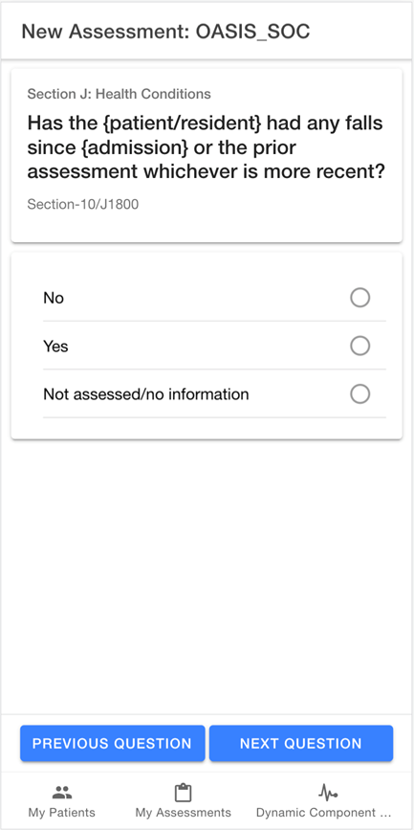
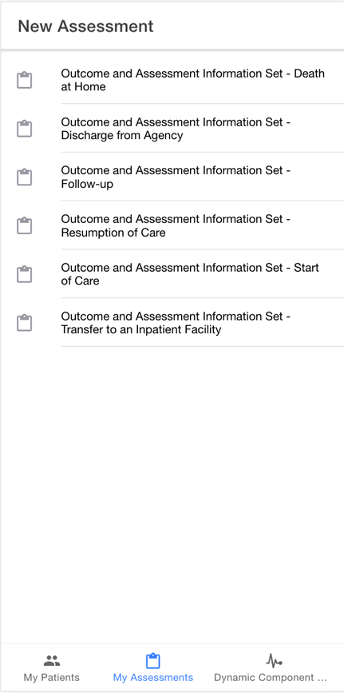
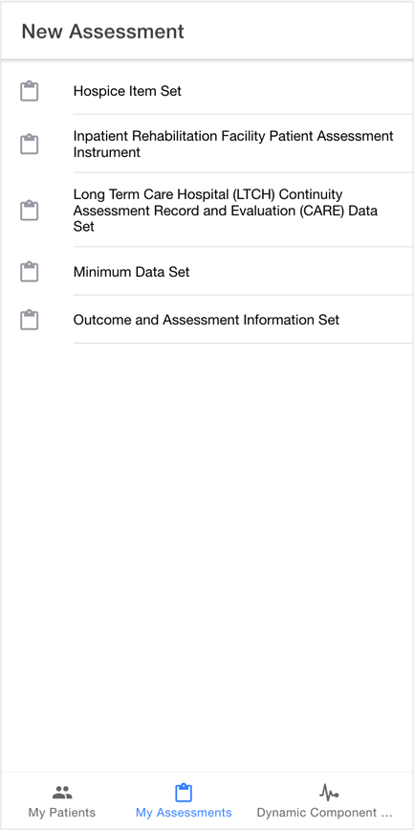
Vendor Implementations
Source: Prepared Health

Slide 14
PACIO Project

Slide 15
PACIO Use Case
The use case includes the following aspects:
Social History
Medical History
Medications
Care Team
Encounters with Hospital Providers
Encounters with SNF Providers
Transfer to ED/Acute Care Hospital

Slide 16
Patient Social History
Ms. Betsy Smith is a 69 year old white female widow
Retired 3 years ago
Moved from Maryland to Texas
Prior to her retirement, she worked as a receptionist in a hotel lobby
Depends on her social security check as her primary source of income
Patient lives alone
Remains independent in her Activities of Daily Living (ADLs)
Functionally independent with a cane
Drives her own car to get to medical appointments
Increasingly reliant on friends to drive her, due to intermittent dyspnea and blurry vision in her right eye
She has two children, a son and a daughter, who still reside in Maryland
Daughter works as an accountant, is married and has children
Son lives alone and works as a lawyer
Communication is poor between family members and Ms. Smith rarely discusses her healthcare with them

Slide 17
Patient Medical History
PAST MEDICAL HISTORY
Patient leads a sedentary lifestyle and follows a poor diet with little exercise, which is a result of low health literacy, poor social support and multiple comorbidities.
Patient has also started to experience frequent falls due to the osteoarthritis of the right hip. Patient was diagnosed with the following while she was in Maryland:
• Hypertension • Depression
• Hyperlipidemia • Cataracts
• Stage 3 chronic kidney disease • Osteoarthritis
• Ischemic heart disease • Type II diabetes

Slide 18
Patient Current Medications
Patient has a complex medication list, which contributes to poor adherence
• Lisinopril 40mg twice a day • Glargine 24 units SQ nightly
• Atorvastatin 40mg nightly • Insulin 3 units with each meal
• Calcium 500mg daily • Sertraline 25mg nightly
• Vitamin D 800IU daily • Tylenol 650mg every 6 hours or as needed
• Furosemide 20mg daily
• Ferrous Sulfate 325mg three times a day prior to meals

Slide 19
Patient Typical Healthcare Follow Up
Patient does follow up with the primary care physician (PCP) and nephrologist regularly, but other specialist follow up is often sporadic. The PCP has been central to the patient’s healthcare information management
• PCP • Cardiologist
• Endocrinologist • Nephrologist
• Psychiatrist • Ophthalmologist
• Retail Pharmacy • Lab Services

Slide 20
Patient Encounter with Hospital Providers
Ms. Smith has as a right hip replacement in the hospital and is assessed by the Physical Therapist (PT) in the Occupational Therapist (OT) after surgery
Initially, patient has strict precautions for her right hip, which includes minimizing flexion of the right hip and right knee & minimizing weight bearing activity
As patient nears discharge, the PT/ OT reassess for discharge planning Ms. Smith and document:
Function: Patient requires a walker with 1 person on standby to walk 12 steps with 2 turns. Patient can use a bedside commode with 1 person to assist her in getting out of bed. Patient requires supervision or touching assistance when completing self care activities
Goals: Return to her baseline functional status (independent with a cane)
Ms. Smiths PT/ OT notes are e-faxed to multiple SNF’s as part of the referral process
Notes:
http://www.marylandattorneygeneral.gov/Health%20Policy%20Documents/adirective.pdf
https://hhs.texas.gov/laws-regulations/forms/advance-directives

Slide 21
Patient Encounter with SNF Providers
Ms. Smith was admitted from the hospital to the SNF to continue the Physical Therapist (PT) in the Occupational Therapist (OT) rehabilitation after surgery
Initially, Ms. Smith required partial to substantial assistance on her functional status
Goals: Ms. Smith’s goal remains the same as in the hospital to return to her baseline functional status (independent with a cane) and return home once she can safely do so
Ms. Smith’s functional status was assessed within the first 3 days using the assessment scale on the Minimum Data Set (MDS)
Once it was determined that Ms. Smith could return home safely with home health care to continue her PT and OT a discharge planning was initiated
An MDS assessment of Ms. Smith’s functional status was completed assessing her usual performance within the 3 days prior to discharge
The functional status assessments were shared with the HHA along with the transfer form and Ms. Smith’s goals
Notes:
http://www.marylandattorneygeneral.gov/Health%20Policy%20Documents/adirective.pdf
https://hhs.texas.gov/laws-regulations/forms/advance-directives

Slide 22
Patient Transfer to ED/Acute Care Hospital
On December 31st Ms. Smith was walking in her home, slipped and fell. She was not able to get up on her own and was able to call 911 to transfer to the hospital emergency room
During triage, the admitting nurse reviewed Ms. Smith’s history, her recent hip replacement surgery and subsequent transfer to post-acute care
The nurse was obtained the Home Health functional status assessments to determine to assess her level of functioning and determine the extent of changes as a result of the fall
The nurse was assessing whether a hospital admission was warranted and obtained the functional assessment from the SNF to assist the PT and OT with their evaluations

Slide 23
PACIO Implementation Guides
Developing two HL7 FHIR Implementation Guides
Functional Status
https://paciowg.github.io/functional-status-ig/
Cognitive Status
https://paciowg.github.io/cognitive-status-ig/

Slide 24
Reference Implementation
Developing a Transfer Summary FHIR reference implementation
Demonstrates both Functional and Cognitive Status use cases
Sample Data:
Use Case: https://github.com/paciowg/sample-data
FHIR Format: https://github.com/paciowg/connectathon-data
Hosted Reference Implementations
Server: http://hapi.fhir.org/baseR4
Client: https://snf-transfer-summary.herokuapp.com/
Reference Implementation Code (Apache 2.0 license)
Server: https://github.com/jamesagnew/hapi-fhir
Client: https://github.com/paciowg/transfer-summary-ri-client

Slide 25
Notable Achievements during Connectathon
Good collaboration and discussion around requirements and IG design.
We had two clients working with the current version of the implementation guide.
Both clients were able to display sample data from the functional status and cognitive status observations.
This includes snapshots of a point in time using the Bundled Observation as well as performance over time using the individual Child Observations.
Several issues and improvements were identified with the implementation guide. Some were added/fixed during the connectathon and others will require more discussion.

Slide 26
Discovered Issues
More sample data is needed to further test and refine the implementation guide
Many questions were raised regarding the requirements and data mappings
Lookback periods
Different LOINC codes corresponding to different lookback periods
Unique identifiers for questions
“Rolling up” individual observations to get a snapshot
Tracking goals
Should observations be sortable

Slide 27
Next Steps
Technical team needs to meet to discuss discovered issues and possible ways to resolve them
Discuss issues and decide on the best course of action during PACIO meetings

Slide 28
Demonstration

Slide 29
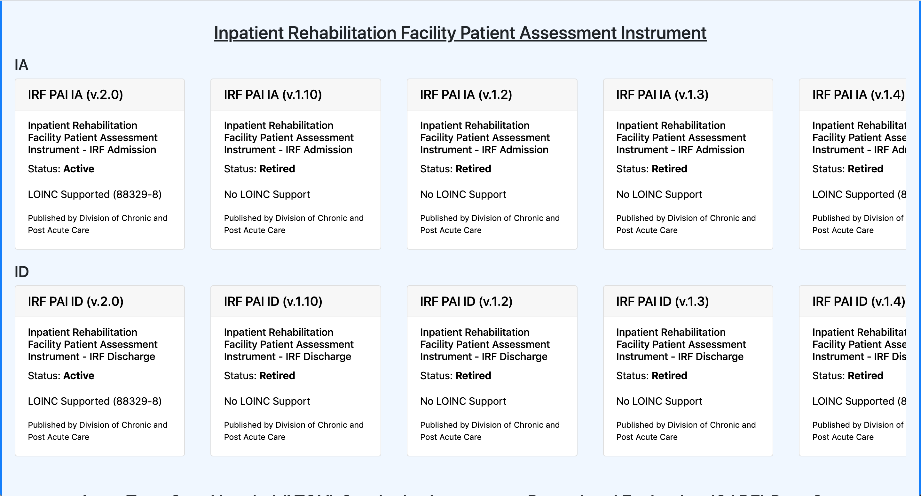
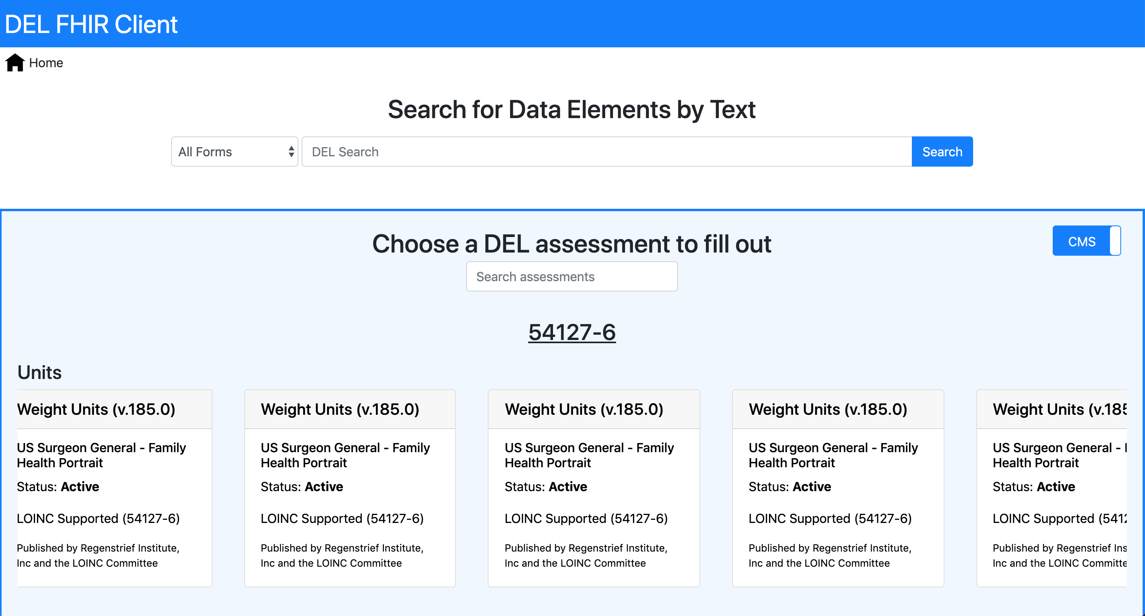
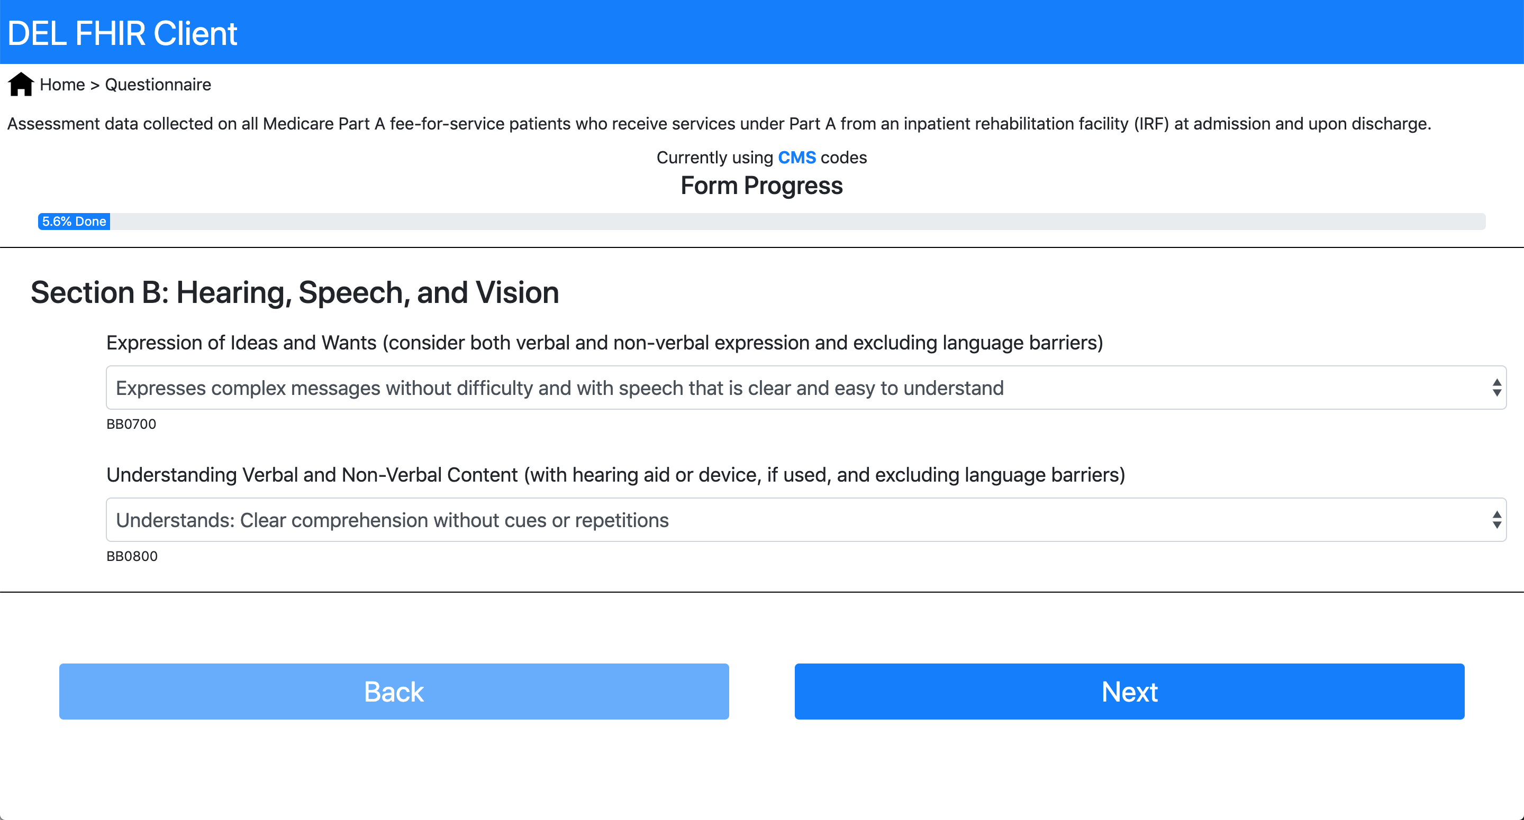
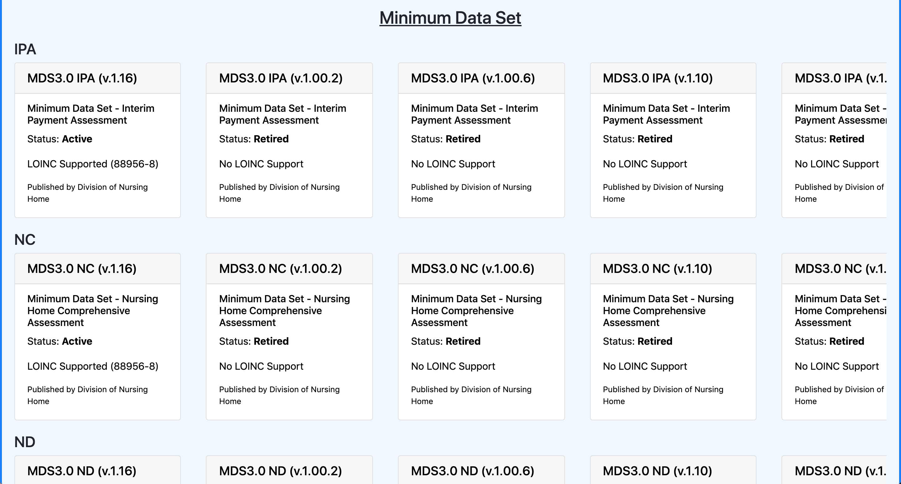
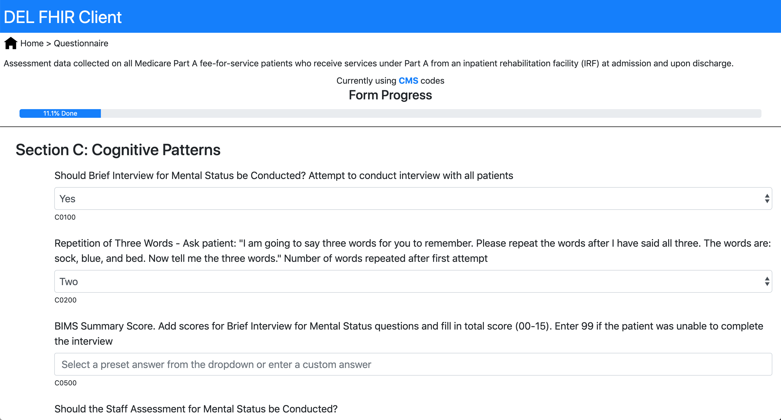
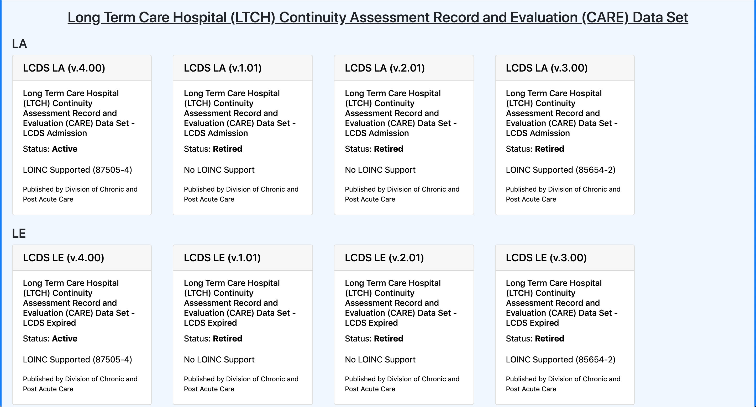
Pseudo-DEL Reference Implementation

Slide 30
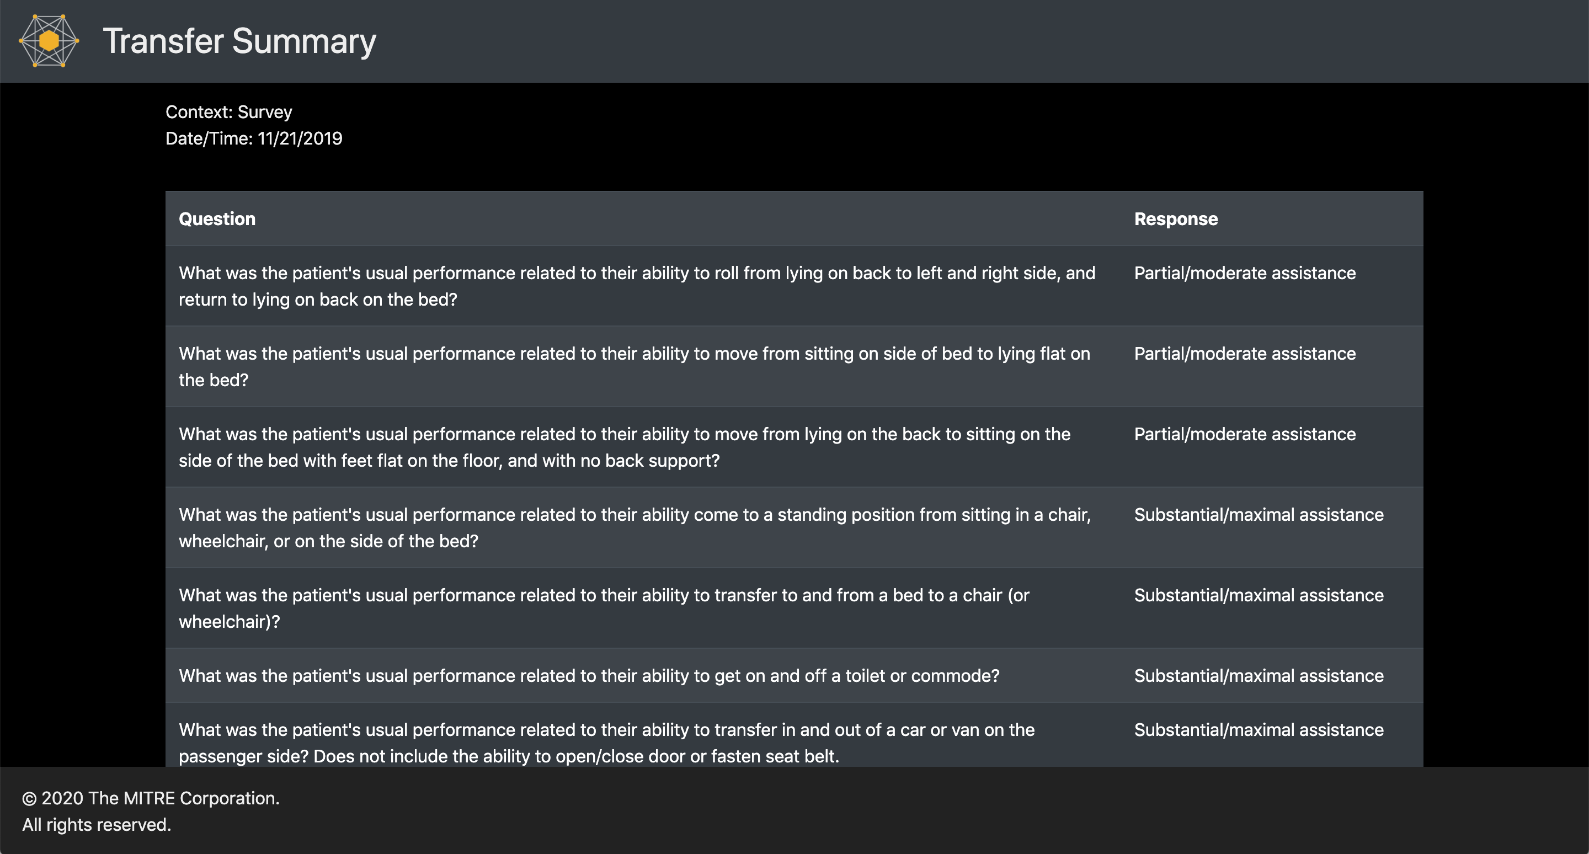
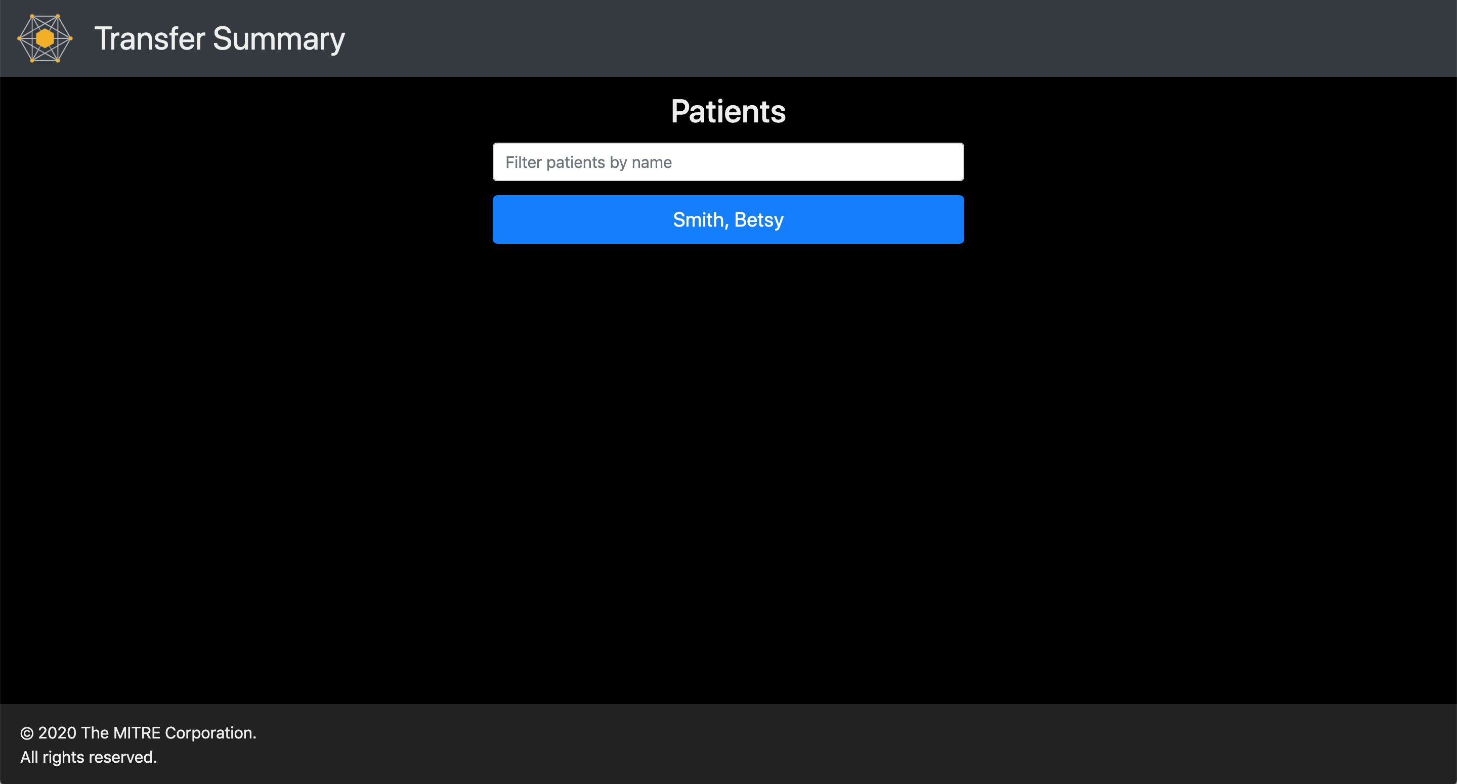
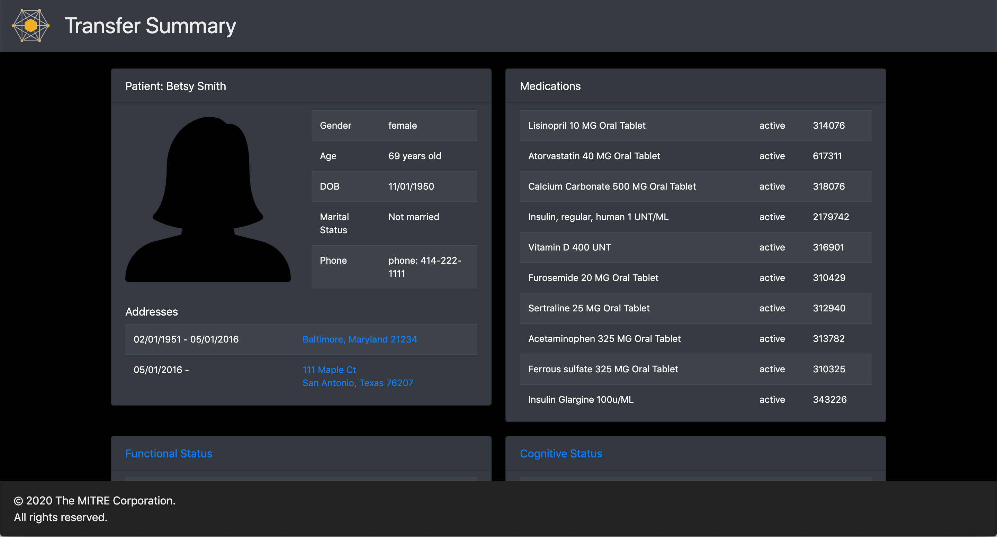
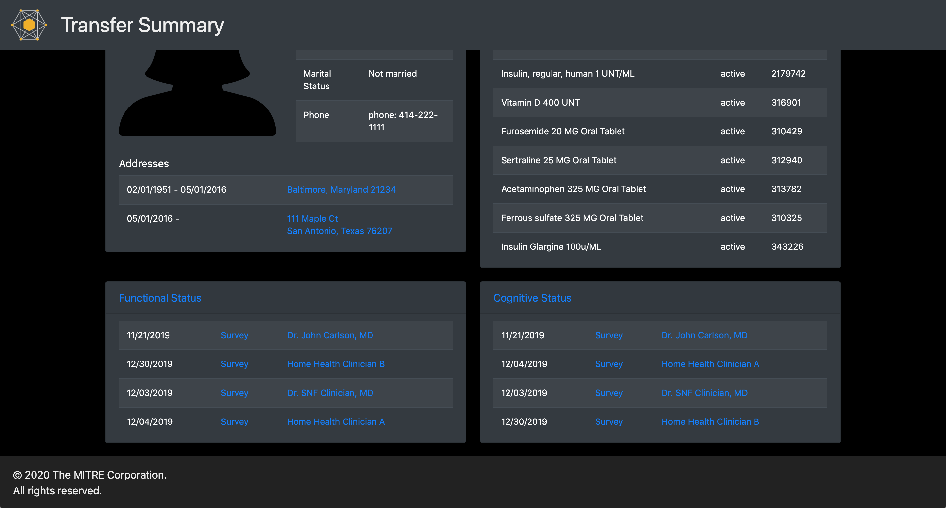
Reference Implementation (Client)
Source: MITRE

Slide 31
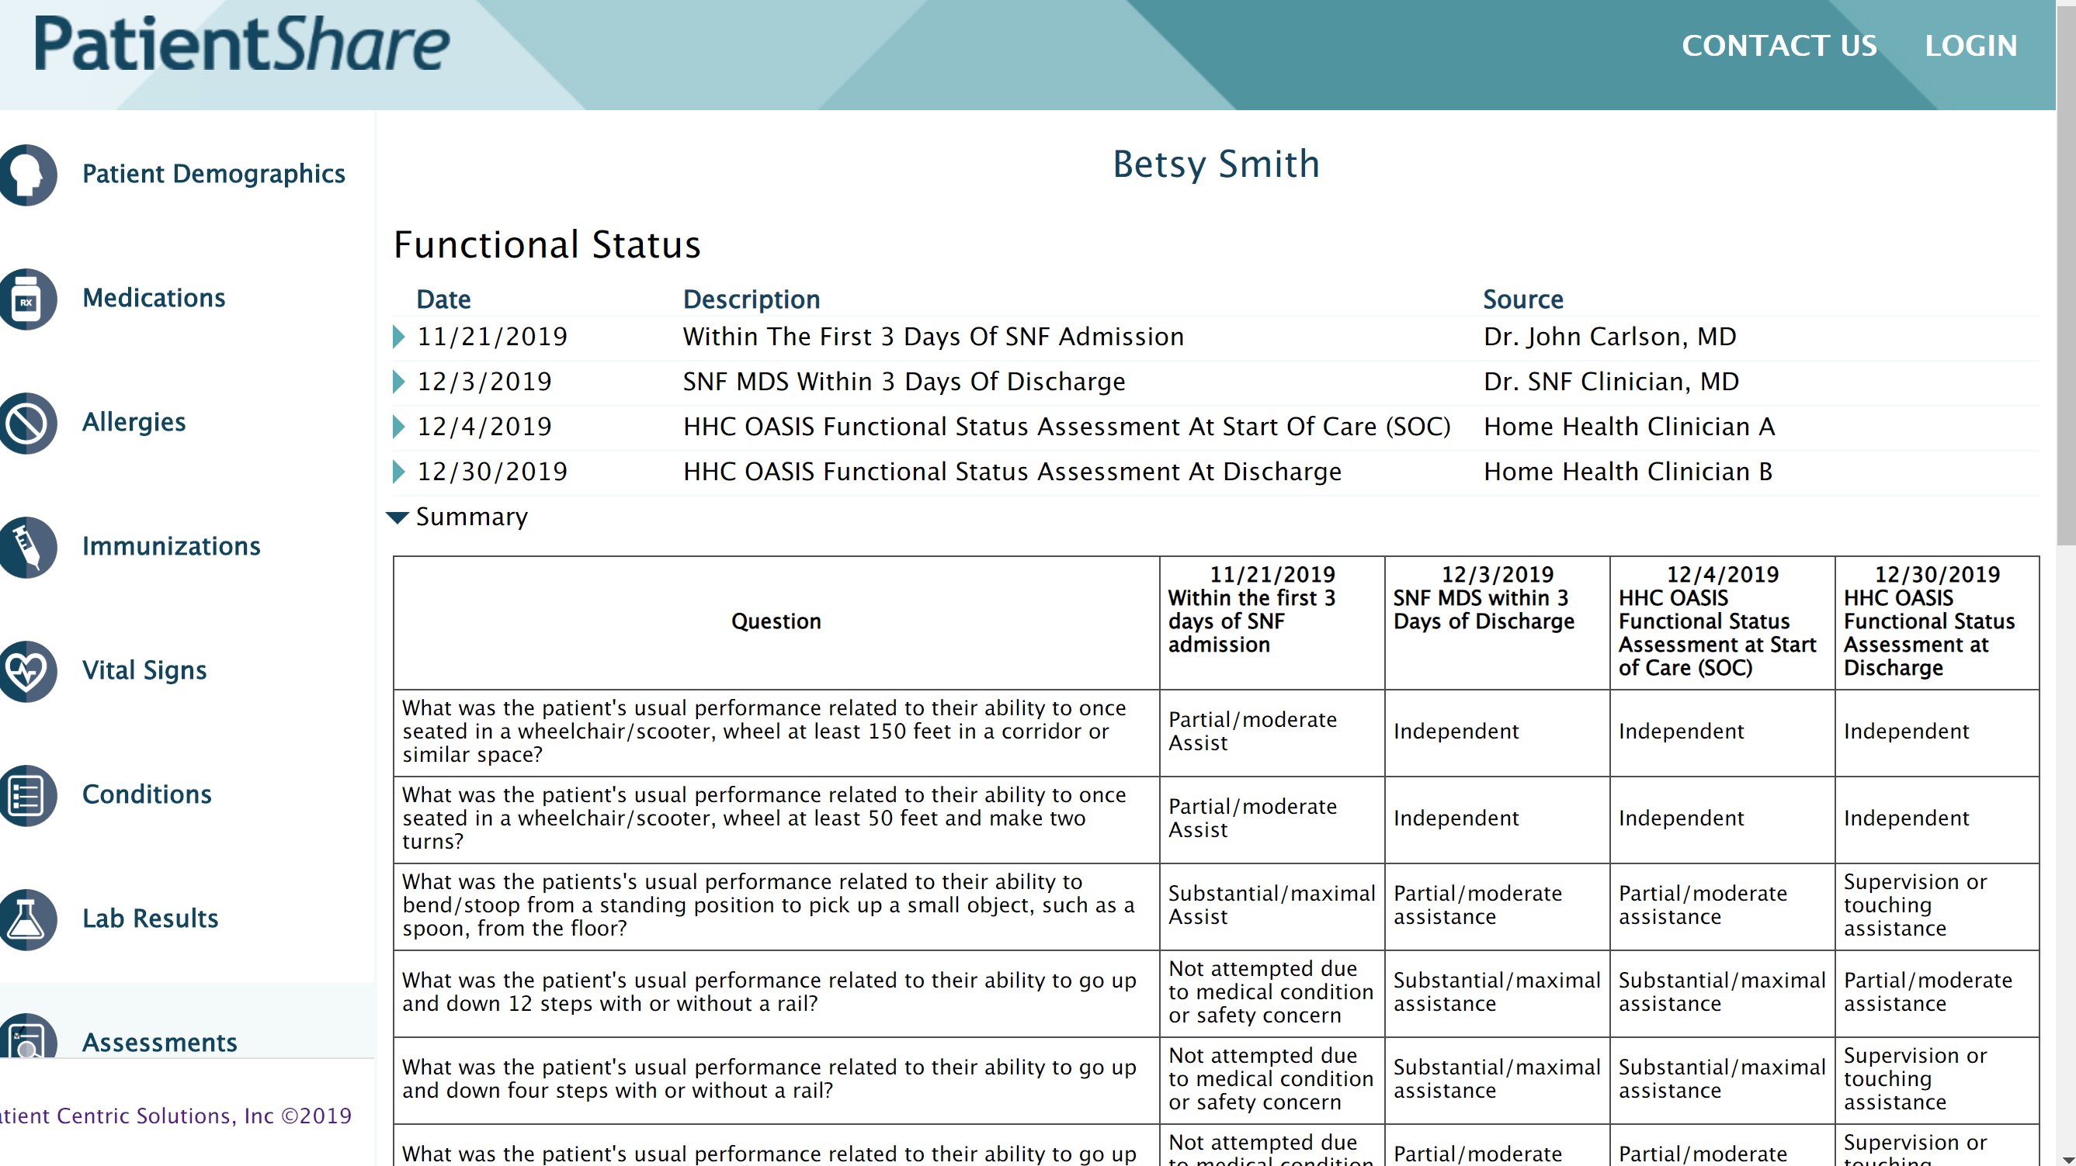
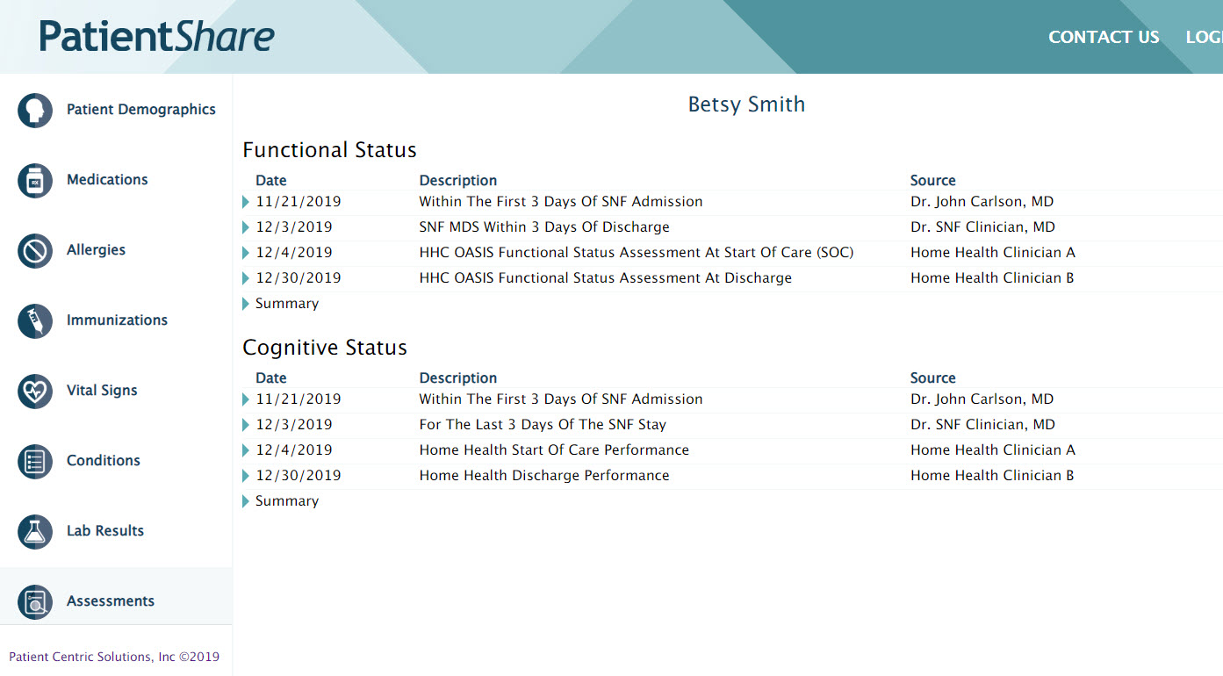
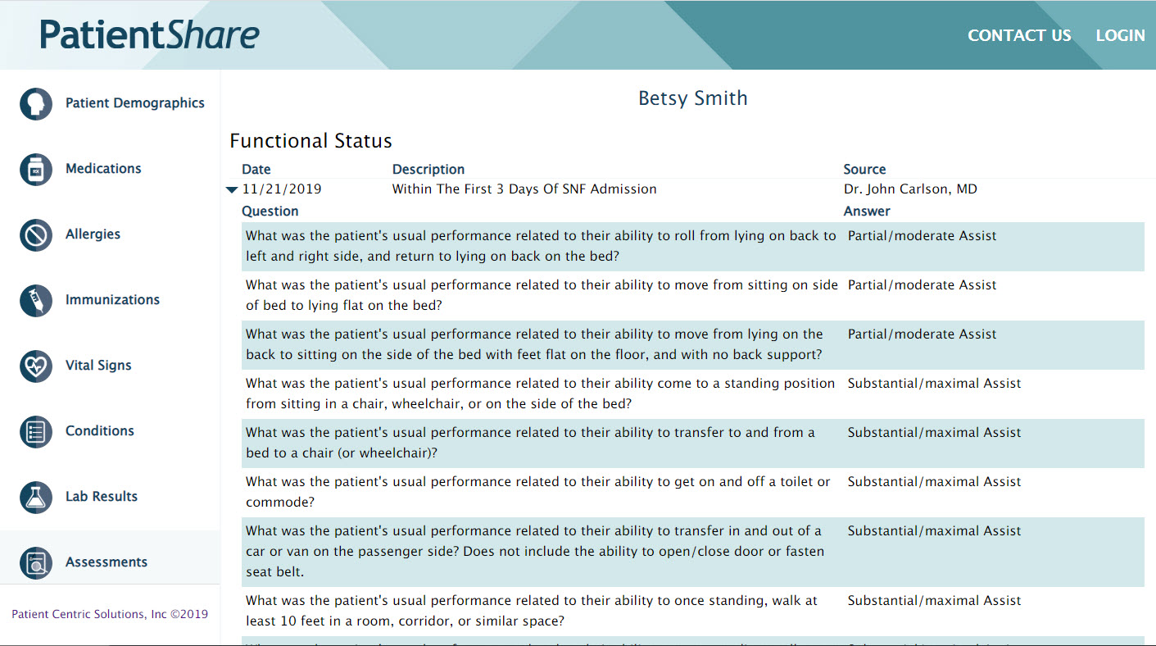
Vendor Implementation
Source: The Lush Group

Slide 32
THANK YOU!!
Use Case:
Michelle Dougherty (RTI), Beth Connor (CMS), Siama Rizvi (MITRE), Dave Hill (MITRE)
Sample Data:
Zabrina Gonzaga (Lantana Consulting Group), Leigh Ann Frick (Care Navigation Consulting), Michelle Dougherty (RTI), Siama Rizvi (MITRE)
Implementation Guide:
DEL: Sean Mahoney (MITRE) and Tim Shaffer (MITRE)
PACIO Project (Cognitive Status): Rob Samples (ESAC) and Tim Shaffer (MITRE)
PACIO Project (Functional Status): Chris Pugliese, Sean Mahoney (MITRE)
Reference Implementation:
DEL Client: Jake O’Donnell (MITRE)
DEL Server: Tim Shaffer (MITRE)
PACIO Project Client: Nancy Lush (Lush Group) and Dave Hill (MITRE)
PACIO Project Server: Tim Shaffer (MITRE)

Slide 33


